Slide 1
Landscapes
Contributors: Tamara Pico
Keywords: geomorphology, landscapes, scientific endeavor, Indigenous peoples, U.S. Western Expansion, scientific racism
Location: western United States, global
People: John Wesley Powell, Mary Somerville, Louis Agassiz, Mary Agassiz, Arnold Guyot, William Morris Davis, Grove Karl Gilbert, Nathaniel Shaler
Last updated: December 6, 2020
Visit https://geo-context.github.io for the teacher’s companion guide to these slides.

Slide 2
Geomorphology: the study of landscapes
Landscapes were studied by many scientists, who helped develop the geoscience discipline in the 19th century
John Wesley Powell (U.S. Geologic Survey Director)
Mary Somerville (first physical geography textbook 1848)
Louis Agassiz and Nathaniel Shaler (professors at Harvard, trained many scientists)
Arnold Guyot (founding professor of geoscience at Princeton)
Grove Karl Gilbert (president of Geologic Society of America)
William Morris Davis (president of Geological Society of America)
Backdrop to 19th century research and teaching on landscapes:
Imperialist projects, including government-sponsored expeditions, which sought to describe topography/landscapes in territories to justify who should live on and use the land
→ many of these scientists were involved in research in scientific racism, for example using physical geography to designate the inferiority or superiority of human races that evolved on different landscapes
Notes:
Geomorphology is the study of landscapes and there were many scientists studying landscapes in the 19th century during the formation of geology as a discipline. For example, John Wesley Powell wrote about rivers and canyons, and was a leader of the USGS, Mary Somerville, wrote the first english physical geography textbook, Louis Agassiz and Nathaniel Shaler, were prfoessors at Harvard, and Arnold Guyot was the first professor of geoscience at Princeton. William Morris Davis is someone who we might recognize as the first of modern geomorphologist, and wrote alot about river evolution through time.
The historical backdrop for these 19th century landscape scientists in the United States was western expansion and other imperialist projects that the US government was involved in, including government sponsored expeditions that hired geologists to describe landscapes and topography, with the aim of determining how land should be used and who should use it.
Many of these scientists (labeled by orange) were involved in research in scientific racism, and some used landscapes themselves to justify the inferiority or superiority of different human races.

Slide 3
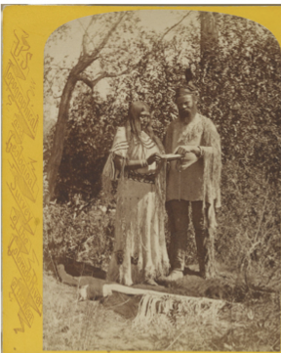
John Wesley Powell
Led the 1869 Powell Expedition, the first U.S. government–sponsored expedition through the Colorado River into the Grand Canyon
Contributions of the local native people downplayed in Powell’s accounts, including knowledge of the land (a main objective of the expedition)
Studies on language of the Ute people inhabiting canyonlands sought to prove the inferior “barbaric” status of Native American culture
Government reports recommended Native American assimilation; Later Powell established the U.S. Bureau of Ethnography
Accompanied by Grove Karl Gilbert on later expeditions to the Rocky Mountains
“… next to teaching them to work, the most important thing is to teach them the English language. Into their own language there is woven so much mythology and sorcery that … the ideas and thoughts of civilized life cannot be communicated to them in their own tongues.”
— Powell, Report on the condition of the Ute Indians of Utah, 1873
Powell poses with Tau-Ruv, a Ute woman, with a mirror case. Clothing worn by both sewn by Powell’s sister for Smithsonian Museum. Photograph by Hillers, 1874.
Notes:
John Wesley Powell is famous for leading the first government sponsored expedition into the Grand Canyon. At the time, reports of his expedition were popular, and published in what might be travel magazines today, celebrating Powell as a hero and important discoverer. However, Powell’s accounts show how he downplayed the importance of contributions of Native AMericans to his expedition, who helped guide the expedition, and also had very detailed knowledge about the topography. In his reports, Powell justifies the superiority of his knowledge, which he claims is more general and more important, than the topographic knowledge held by native americans, which he admits puts him “to shame”.
Powell was inspired to study the Ute people of the canyonlands on his first expedition, and returned to conduct ethnographic studies on their language, describing how their language demonstrates the inferiority of Native American culture as barbaric. At this time, there was an idea inspired by a form of social darwinism (unicultural evolution) that culture evolved from savagery to barbarism to civilized, and that different human races could be categorized on this scale as inferior or superior, and so Powell used this framework in his anthropologic studies.
In reports to the US government, Powell made recommendations for Native American assimilation - read quote.
This picture shows Powell posing with a Ute woman, wearing clothing that was designed and sewn by Powell’s sister for display at the Smithsonian Museum.
Although G.K Gilbert, someone considered foundational to the field of geomorpholgoy, was not involved in these types of anthropologic studies, he accompanied Powell on later expeditions into the Rocky Mountains.

Slide 4
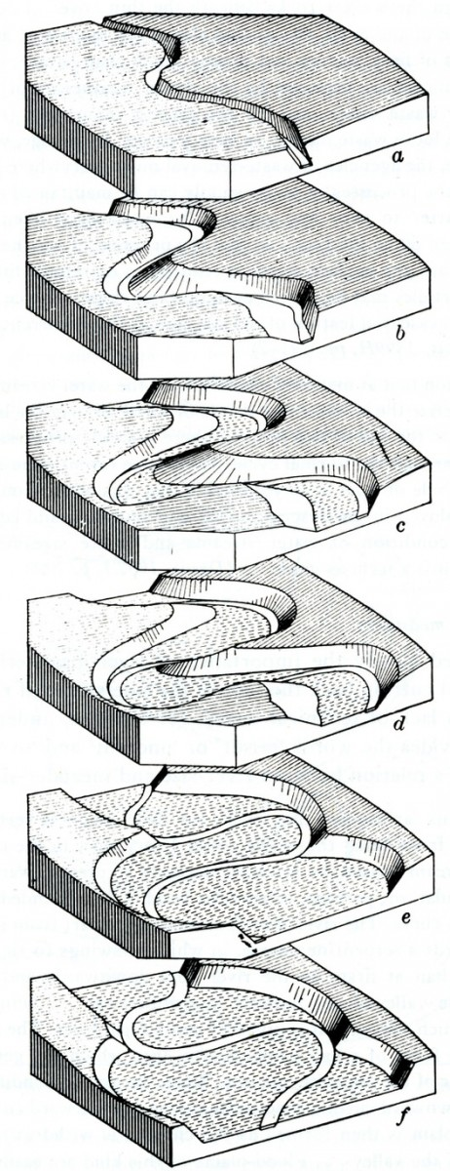
William Morris Davis and Race
Proposed concept of a river’s “life cycle” from young to mature describing stages of river evolution through time.
Wrote geography textbooks (e.g. Elementary Physical Geography, 1902) connecting topography and climate to superiority/inferiority of human races.
These ideas motivated Earth system studies, influencing scientists and politicians that tried to explain perceived racial differences in physical, mental, and moral attributes by climate and geography
This concept of "environmental/geographic determinism" ultimately inspired the Nazi slogan “Blood and Soil”, used to justify eugenics program
“The study of physical geography...gives a knowledge ...so that we may better understand the relation of man and nature. This relationship is of great importance because the progress of man from the savage toward the civilized state has been made by taking advantage of favorable geographical conditions.”
“Few nations among [black, brown, red] races have made important advances towards civilization.”
"Inhabitants of [North America] were savages who did not know how to develop its riches…”
- William Morris Davis, Elementary Physical Geography, 1902
William Morris Davis, Physical Geography, 1898 (Fig 152)
Notes:
William Morris Davis is famous as a founder of modern geomorphology, and proposed the concept of a river’s life cycle through different stages of evolution. The image on the right shows the development of river meanders.
William Morris Davis was passionate about education, and wrote geography textbooks that included material describing connections of topography and climate to the superiority or inferiority of different human races. Here is a quote from his textbook: (read quote)
We can see how these ideas about race and human progress motivated studying the Earth system, and William Morris Davis was influential to other scientists and politicians that tried to explain perceived racial difference in physical, mental, and moral attributes by climate and geography.
This concept is known as geographical determinism or environmental determinism, and ultimately these ideas inspired the Nazi slogan “Blood and Soil”, which described the concept that humans “bloodline” or genetic features were tied to the certain “soil” or landscape, on which they evolved, and this idea in part led to the justification of the Nazi eugenics program.

Slide 5
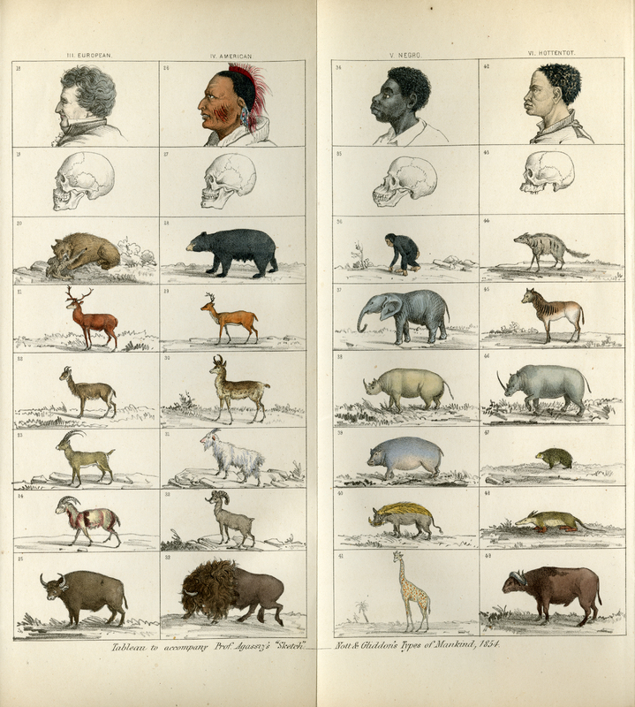
Early landscape geologists and scientific racism
Scientific studies by early 19th century geologists included creating and justifying racial hierarchies
Louis Agassiz: studied glacial landscapes and human races
Advocated for polygenism, the idea that different human races constitute different species
Measured skull sizes and analyzed photographs of different human races in seeking to justify superiority of white races
Mary Somerville: first woman in Royal Astronomical Society, published first English geography textbook
“It seems to be the design of providence to supplant the savage with the civilized man on the continent of Australia as well as in North America though every effort has been made to prevent the extinction of the natives.”
— Somerville, Physical Geography, 1848
“…the deterioration consequent upon an amalgamation of races… is rapidly effacing the best qualities of the white man, the negro, and the Indian, leaving a mongrel nondescript type, deficient in physical and mental energy.”
— Mary Agassiz, writing alongside husband Louis Agassiz, Diary in Brazil, 1868
Louis Agassiz in Types of Mankind, 1854.
Notes:
These ideas were already present in geology earlier during the 19th century. For example, Louis Agassiz, who is famous for studying glacial landscapes, also studied human races. On the right is an image included in Agassiz’s work with drawings comparing different human races to different animals. Agassiz used measurements of skulls of people of different human races to justify a racial hierarchy of inferior to superior human races.
Agassiz was part of the American School of Anthropology, which argued for polygenism, or the idea that different human races are actually different species and so they should not mix or have children together. This idea is quoted on the right, written by Louis Agassiz’ wife Mary Agassiz. The photographs that Agassiz commissioned for these studies were often not taken with consent (see articles on daguerreotype of slaves as well as Diary in Brazil)
Mary Somerville, was the first woman elected to the Royal Astronomical Society, and published the first ENglish geography textbook. In this book we see that these ideas about geography and race are incorporated: read quote

Slide 6
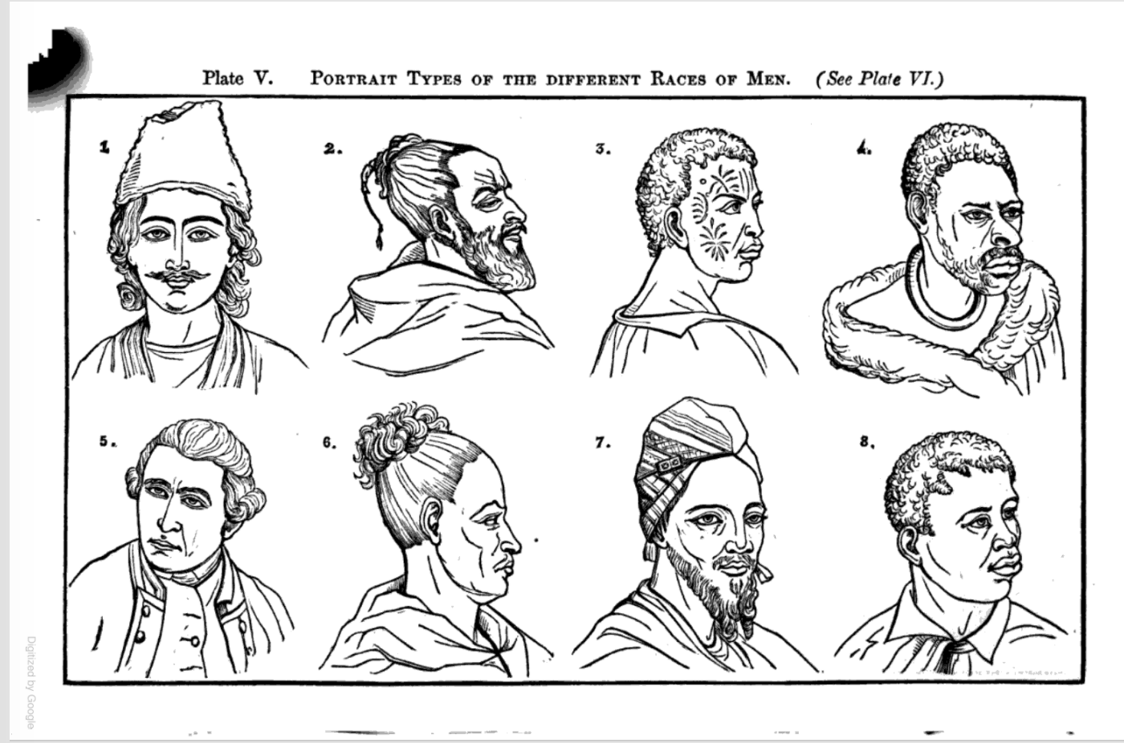
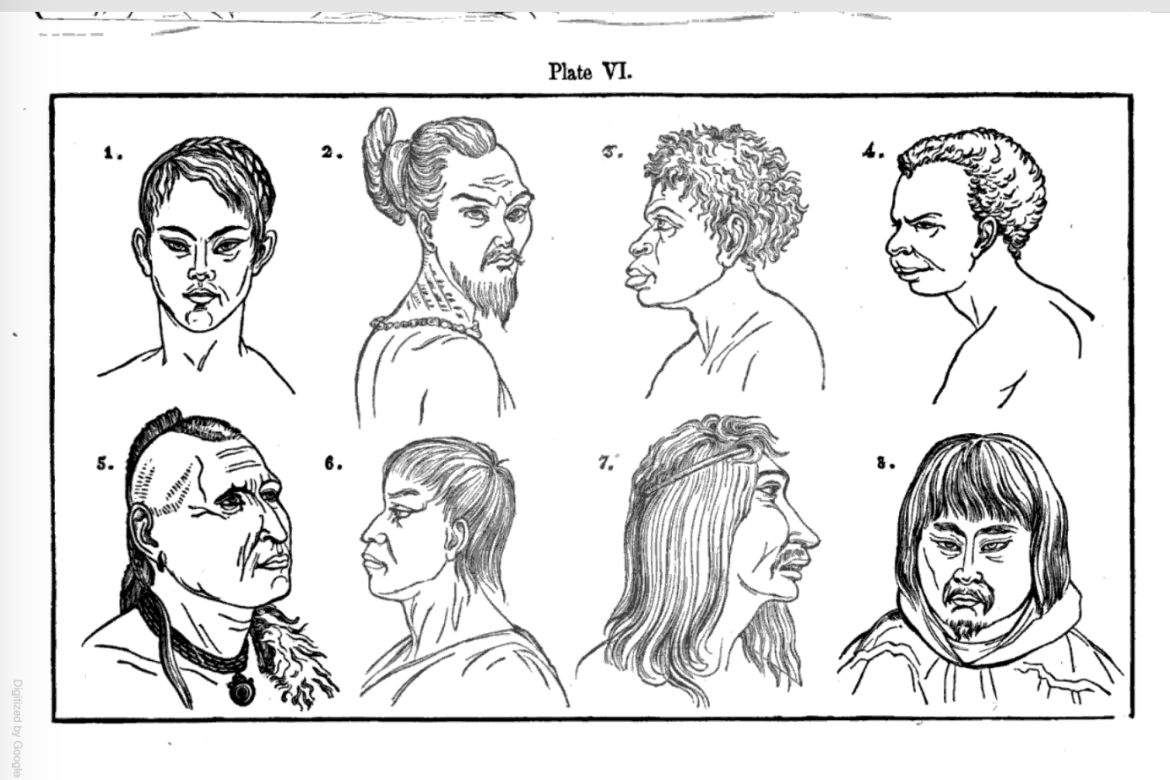
Early landscape geologists and scientific racism
Scientific studies by early 19th century geologists included creating and justifying racial hierarchies
Arnold Guyot: Professor at Princeton gives series of lectures which form Earth & Man textbook to ~1500 teachers in New England. Many attendees incorporated material into their teaching
Connects distribution of continents, topography, and climate to superiority/inferiority of human races in terms of beauty, physical ability, intelligence, and morality (Earth and Man, 1849)
Nathaniel Shaler: claims North American topography is "unfit to cradle great peoples”, argues North America has "peculiar advantages” for American people (of Aryan descent) because the climate and topography of the land is ideal for the institution of slavery
Suggests slavery "led to the rapid accumulation of wealth, and in this way brought the people the sooner into a condition in which they could control their own destiny."
Arnold Guyot, The Earth and Man, 1849
Notes:
Other scientists at this time wrote about similar topics connecting race to landscapes. Arnold Guyot, who founded the geoscience department at Princeton, was encouraged by Louis Agassiz to give tours of New England giving lectures which later formed his book “The Earth and Man”.
These lectures describe how the distribution of continents, topography and climate ultimately determine hierarchy of human races according to beauty, physical ability, intelligence, and even morality. This illustration in his book is accompanied by text claiming the deterioration of beauty as you move away from the European continent.
Nathaniel Shaler, who was trained by Louis Agassiz and was a professor at Harvard, wrote on similar themes connecting topography to inferoriority or superiority of different human races. For example, Shaler claims that North American topography is so complex that it is “unfit to cradle great peoples”, and goes as far as to use North American topography and climate to justify the institution of slavery. Shaler claims there are “peculiar advantages” for those of “civilized races” because the land is ideal for the institution of slavery.

